Slide 1
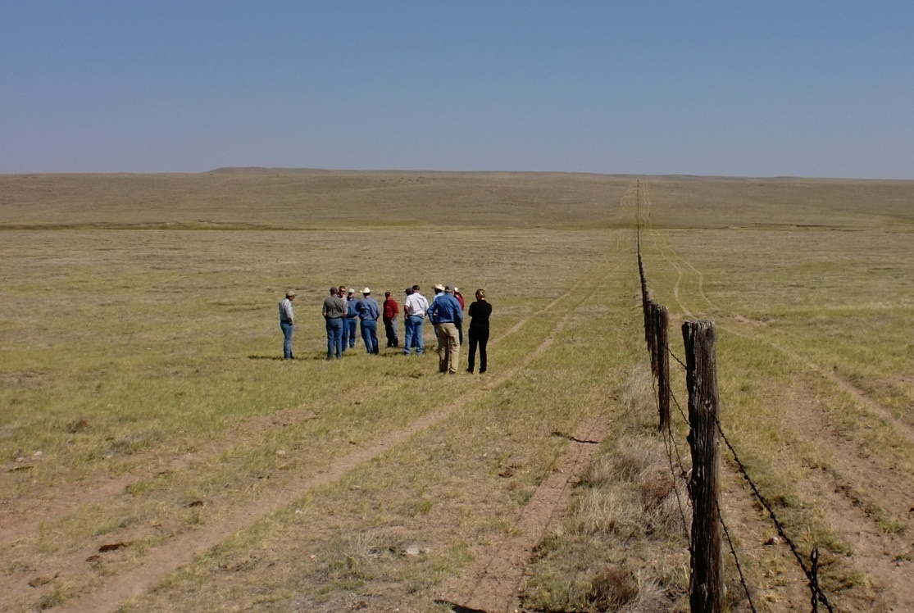
Collaborative Adaptive Rangeland Management (CARM)
David Augustine, USDA-ARS
Angela Dwyer, Bird Conservancy of the Rockies
Notes:
Project started in 2012 by a group of four rangeland scientists working for the ARS, who were charged with writing up a 5-year research plan, outlining the experiments and products we would generate over the next 5 years. We were thinking about how we could improve our interaction with stakeholders, meaning rangeland managers and ranchers.

Slide 2
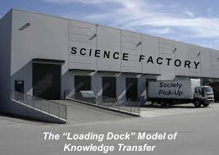
Lack of stakeholder involvement in the scientific process
Motivating Factors
Notes:
Traditionally, many scientists in both academia and government agencies have taken a hands off approach to working with stakeholders.

Slide 3

Disconnect between manager experience and scientific evidence
Motivating Factors
Notes:
Over the past two decades, there has been substantial debate in the rangeland profession over the degree to which various grazing management systems influence rangeland productivity and conservation. Many managers working at the scale of entire ranchers or grazing allotments report that they feel there are ecological benefits of certain rotational grazing approaches, while over 5 decades of research by rangeland scientists, primarly working at smaller spatial scales, has reported minimal or no ecological benefits of rotational grazing regimes. So we wanted to address this controversy by conducting research in a manner that brings together mangers and scientists in the research process.

Slide 4
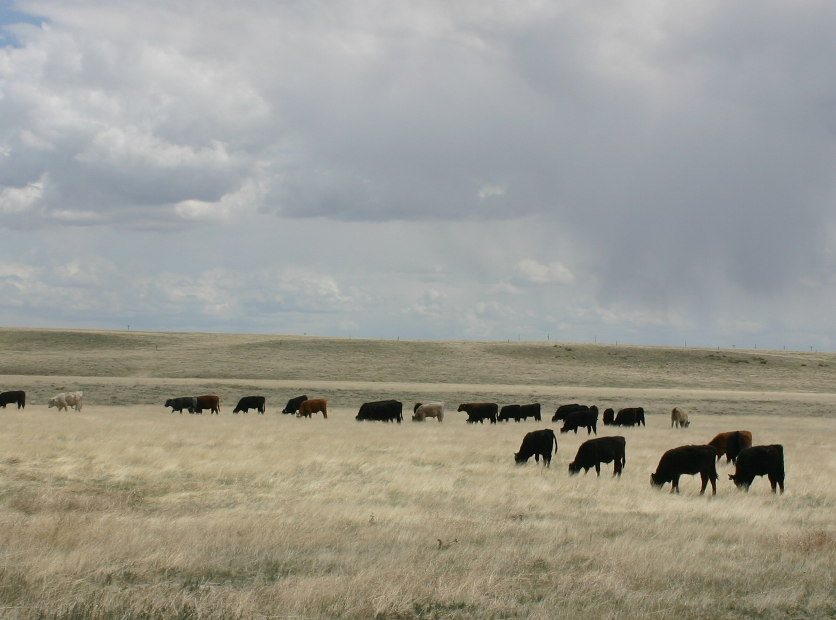
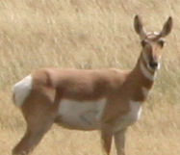
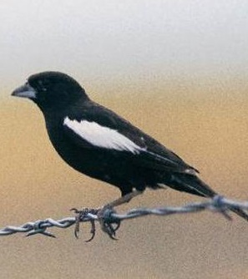
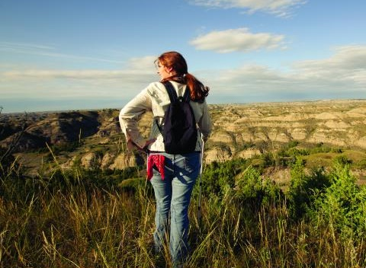
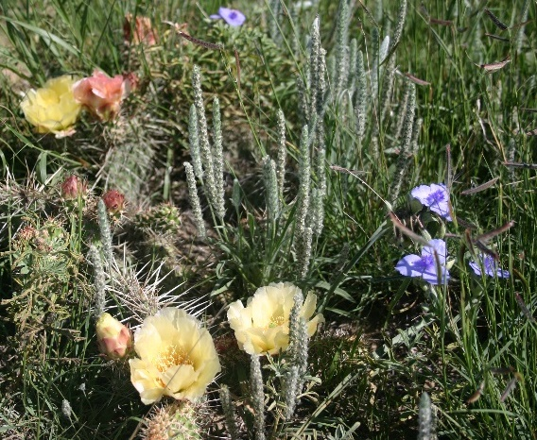
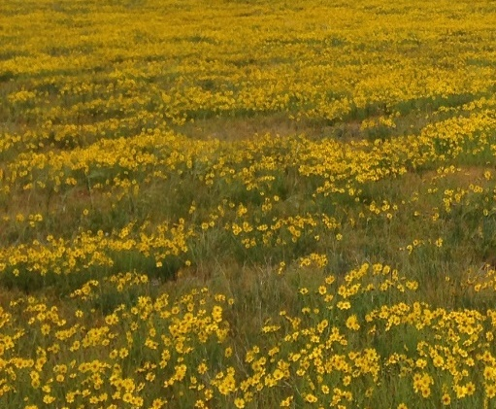
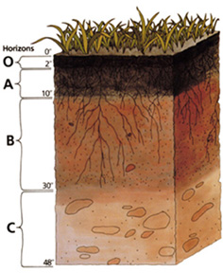
Motivating Factors
Ecosystem goods and services
Notes:
And finally, we recognize that society increasingly values rangelands for much more than just livestock production. We also value things like wildlife habitat and soil carbon, and so we wanted to study multiple ecosystem goods and services in rangelands.

Slide 5
Adaptive Management
Application of experimentation to the design and implementation of resource management.
Management is designed BOTH to achieve management objectives AND increase learning.
Notes:
So the original definition of adaptive management, is the application of experimentation to resource management in order to speed learning and change management in response to new knowledge. Under adaptive management, management is designed both to increase learning and achieve management objectives.

Slide 6

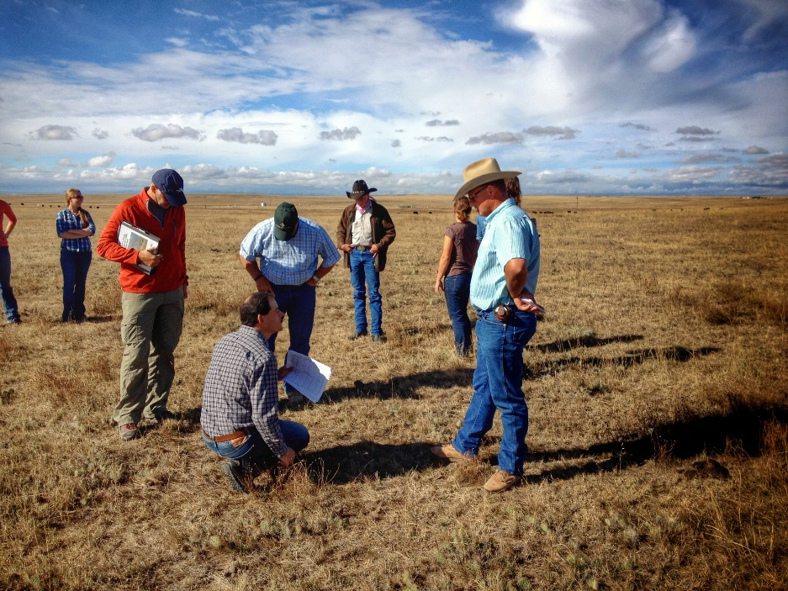
Collaborative Adaptive Management
Involves multiple stakeholders
Draws on all types of knowledge
Notes:
Collaborative adaptive management builds on AM to involve multiple stakeholders and draw on diverse knowledge sources to integrate management and science

Slide 7
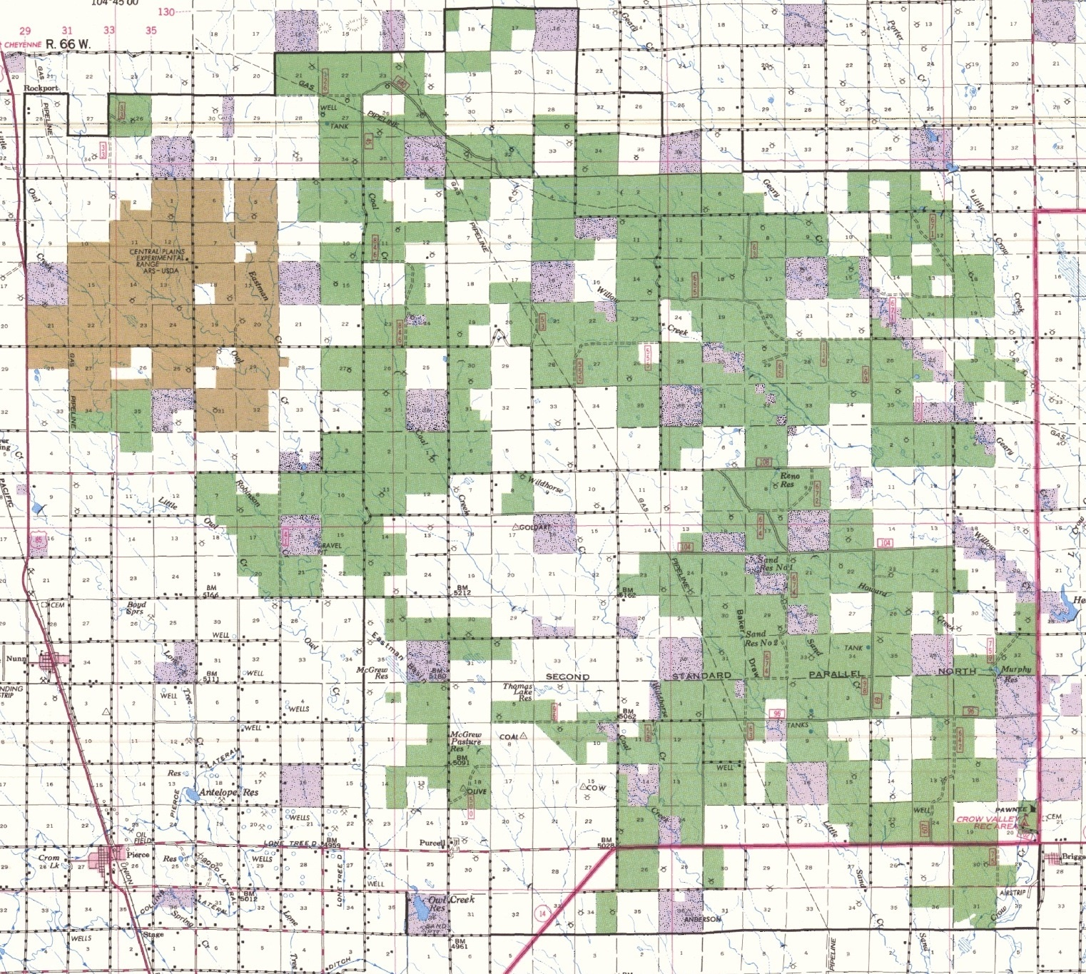
Central
Plains
Experimental
Range
Pawnee
National Grassland

Slide 8
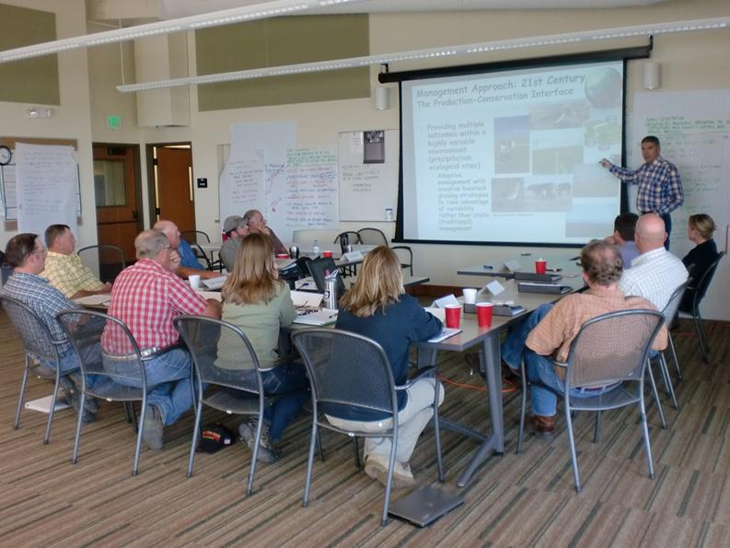
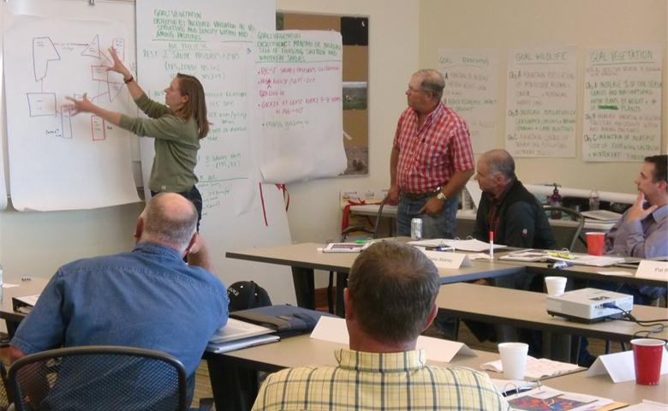
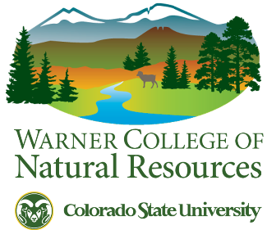




CARM Stakeholders
Crow Valley Livestock Cooperative (4 Ranchers)
Bird Conservancy of the Rockies
Environmental Defense Fund
The Nature Conservancy
Colorado State Land Board
USDA Forest Service
USDA Natural Resources Conservation Service
Colorado State University Extension
Research Collaborators:
Research Collaborators

Slide 9
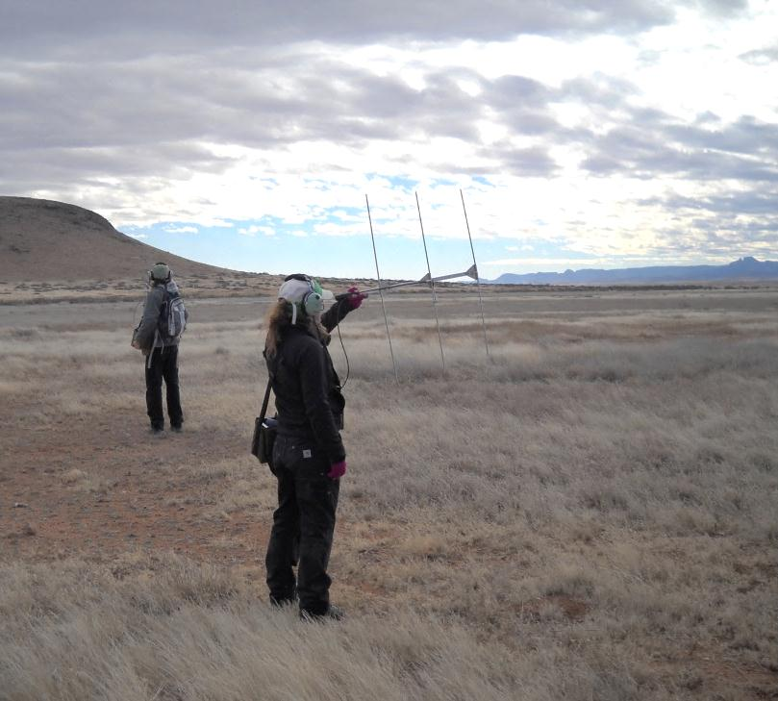
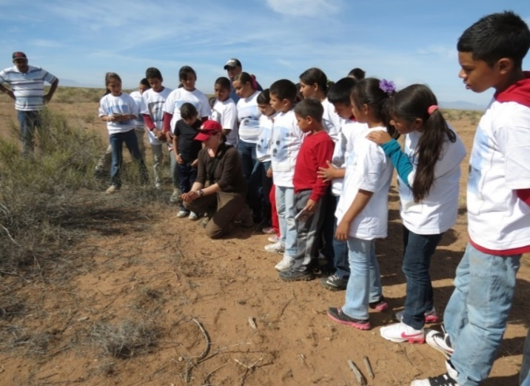
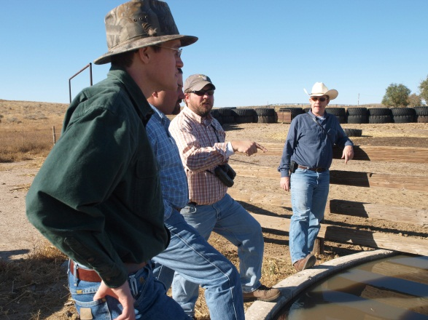
Bird Conservancy of the Rockies
Our mission is to conserve birds and their habitats through an integrated approach of science, education and land stewardship.
We work in 16 US western states, Canada and Mexico for full annual life cycle approach to
bird conservation, and have 12 Private Lands Wildlife Biologists working with farmers and ranchers in USDA: Natural Resource Conservation Service offices.
Most birds use private lands as it encompasses 70% of the landscape; the CARM model can advance bird conservation.
Notes:
As a stakeholder on this project, my role is in part to think about what we can offer and what I can bring back to bird conservancy.
Much of the west is in private land ownership and grassland birds occur largely on private lands throughout their annual life cycle, the CARM model as we’ll talk about can advance bird conservation, and with our private lands wildlife biologists.

Slide 10
Collaborative Adaptive Rangeland Management experiment
Notes:
The Collaborative Adaptive Rangeland Management experiment is an on-going experiment in northeastern Colorado’s shortgrass steppe. The experiment is complex so I’ll simplify it - essentially we have a ranch that is divided equally into two treatments.

Slide 11
Treatment 1: continuous season-long grazing
*
*
*
*
Traditional Rangeland
Management Treatment
Moderate, season-long
stocking (1 herd per
pasture; May 15 – Oct 1)
*
*
*
*
*
*
Notes:
One treatment, shown in purple, consists of continuous, season-long grazing by 10 small herds of yearling steers, with one herd in each pasture. We consider this the “status quo” of grazing management in the shortgrass steppe.

Slide 12
Treatment 2: CARM
*
*
*
*
*
*
*
*
*
*
Notes:
The other treatment, shown in green, is a rest-rotational system where a single large herd of yearling steers is rotated through these pastures with at least 1 pasture in this treatment being rested each year. We use the same moderate stocking rate in both treatments but the rest-rotational herd is 10 times the size of a continuous grazing herd, which results in a combination of short-duration, high-intensity grazing and rest. This herd is adaptively managed by a diverse group of stakeholders.

Slide 13
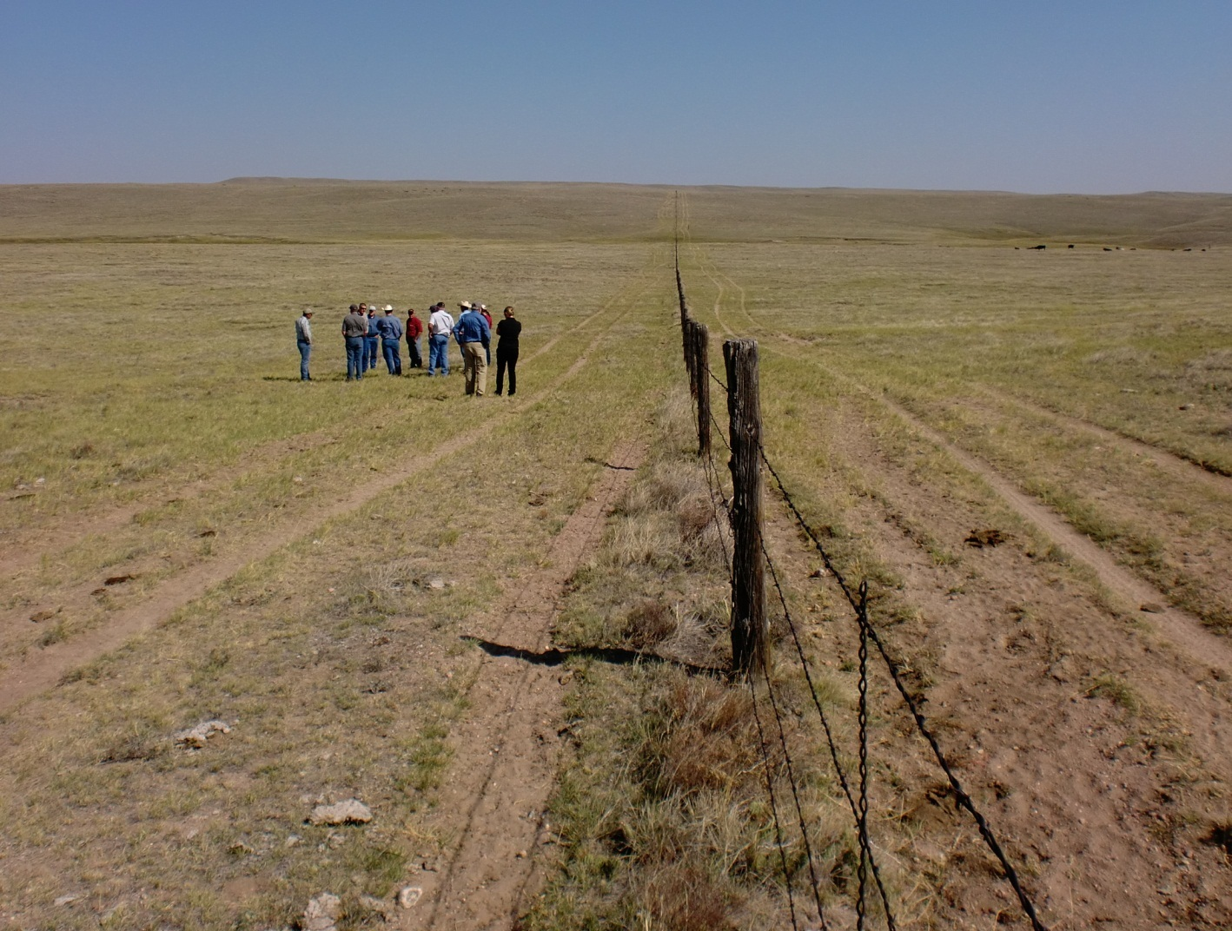
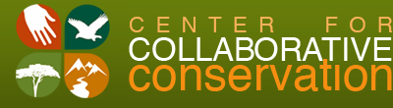
Assess
Adjust
Design
Evaluate
Implement
Monitor
First Workshop: September 2012
Follow-up Meetings throughout 2013
Notes:
What do we know?
What do we want? (objectives/outcomes)
What are our options? (management strategies)
How will we measure success? (indicators)
How will we use this information? (triggers)

Slide 14
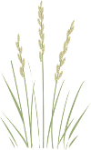

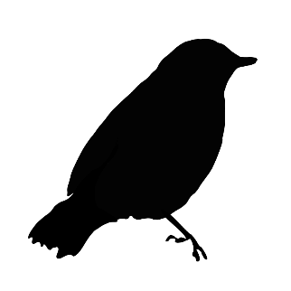

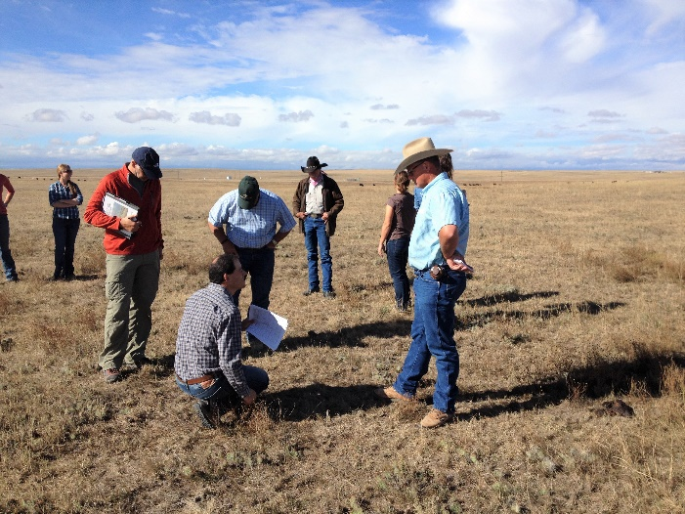
Goal: Manage the land in order to pass it on to future generations
-Economically
-Ecologically
Vegetation
Profitable ranching operations
Wildlife
Collaborative
Learning

Slide 15
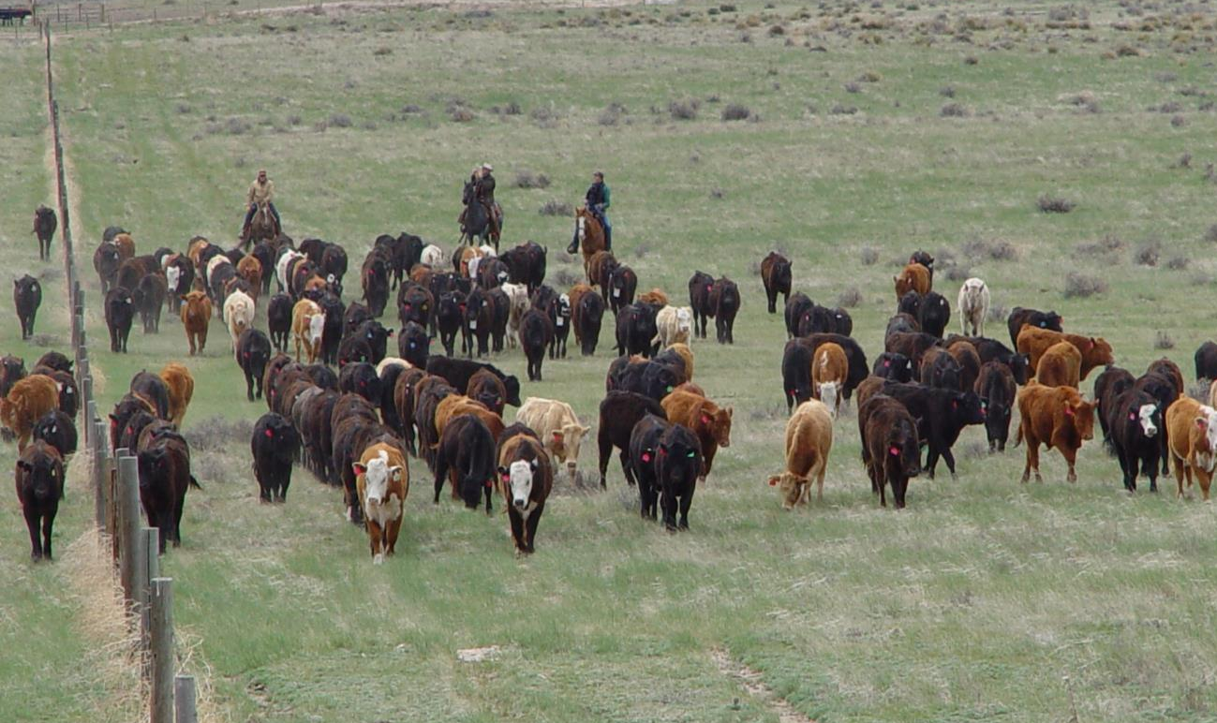
Adaptive Management Plan
One herd of 220 steers
2 rested pastures/yr (grassbanks for dry years)
Movements will consider:
Precipitation
Forage biomass (visual obstruction)
Species composition
Seasonality
Assess
Adjust
Design
Evaluate
Implement
Monitor

Slide 16
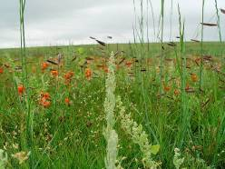
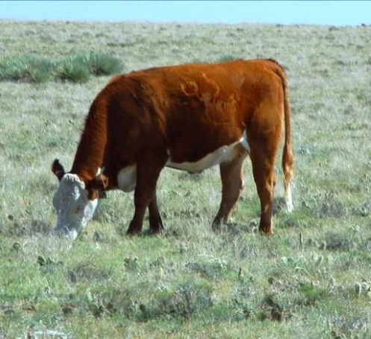
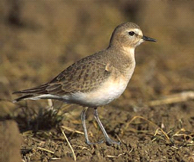
2013: Baseline Pre-treatment Monitoring
2014 – 2019: Annual monitoring of all objectives
Assess
Adjust
Design
Evaluate
Implement
Monitor
Notes:
Baseline monitoring (pre-treatment) took place in summer of 2013. Then treatment monitoring in 2014 when the grazing treatment was implemented. Grazing monitoring was used to make within-season decisions based on the short-term triggers decided by stakeholders (visual obstructuion, diet quality, animal behavior, precip. Etc.). Weekly updates sent to stakeholder on pasture and animal conditions and behavior.

Slide 17
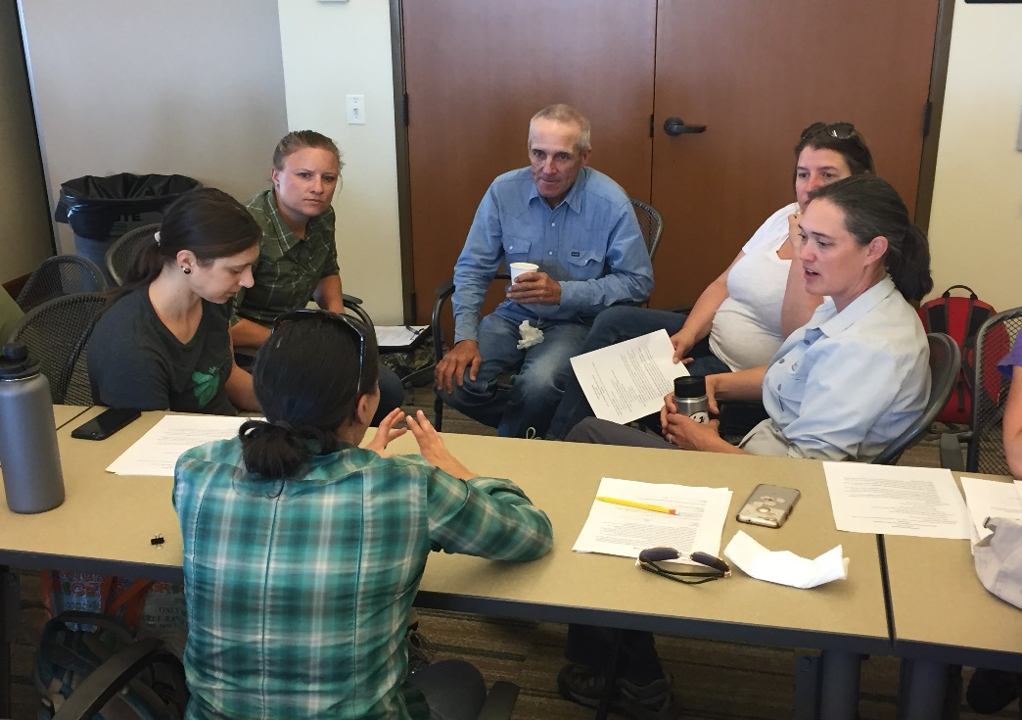
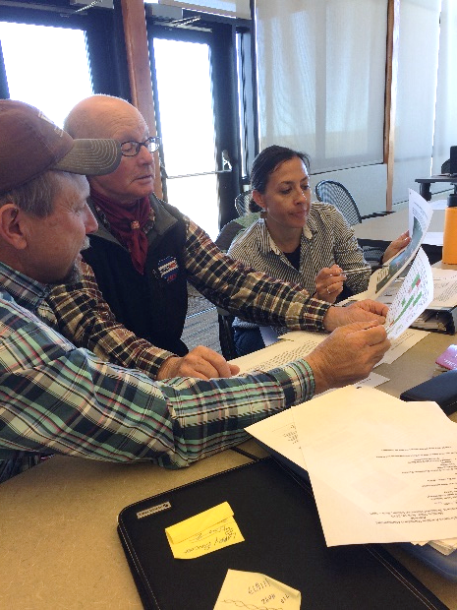
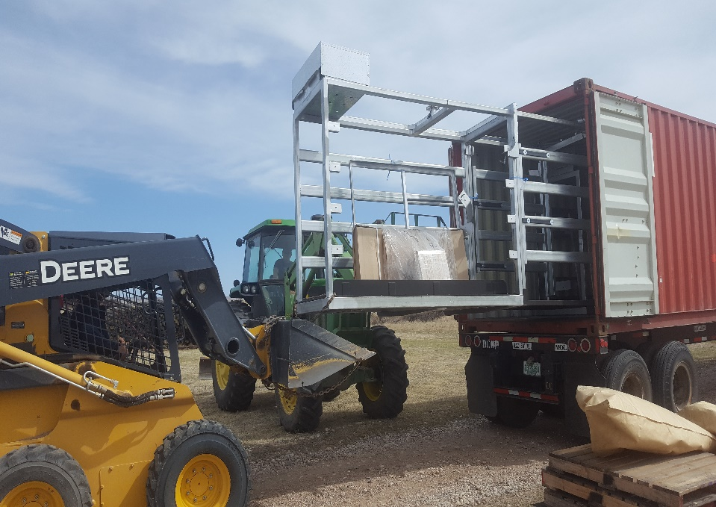
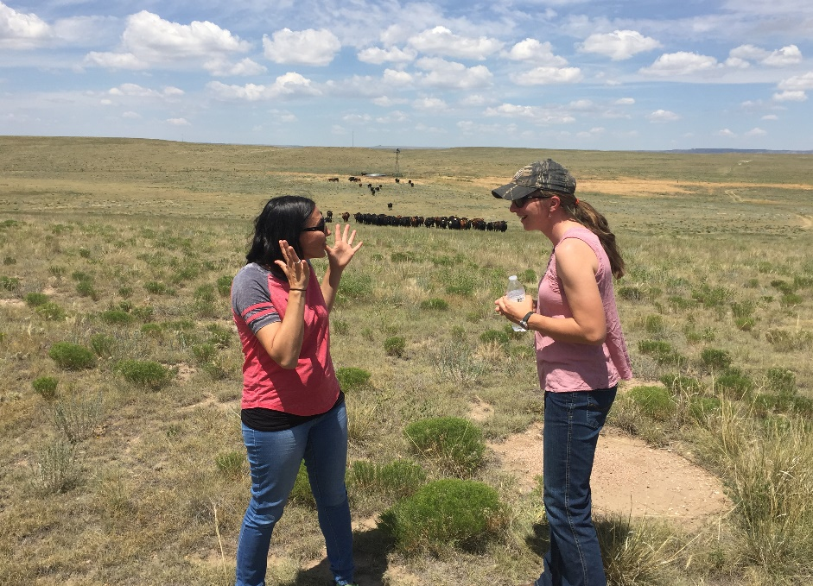
Stakeholder – Scientist Meetings 3x per year: 2014 - 2019
Notes:
The group comes together 3 times a year for discussion of results of the previous season, and planning for the upcoming season. We offer suggested changes and vote for all decisions with a 75% supermajority. We’ve also expanded this over time to include field trips and inviting guests and learning more about the ranchers we work with.

Slide 18
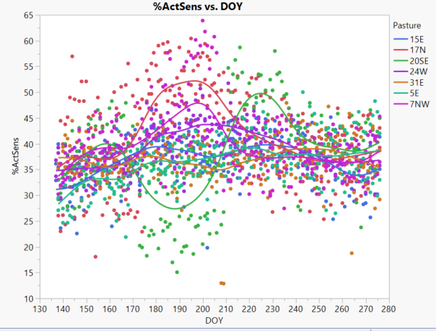
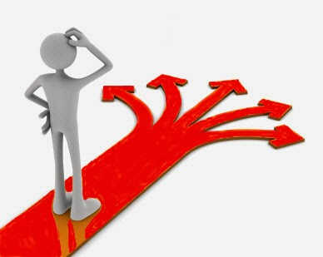
Key components of collaborative meetings:
Engaged discussion of what monitoring results mean
Getting the data is not enough! Time to analyze, engage with, and discuss monitoring results is essential.
Notes:
Engaged discussions on monitoring is the heart of a collaboration, getting data and sharing it alone is simply not enough you must talk it out, a lot of adaptive management projects skips this step.

Slide 19
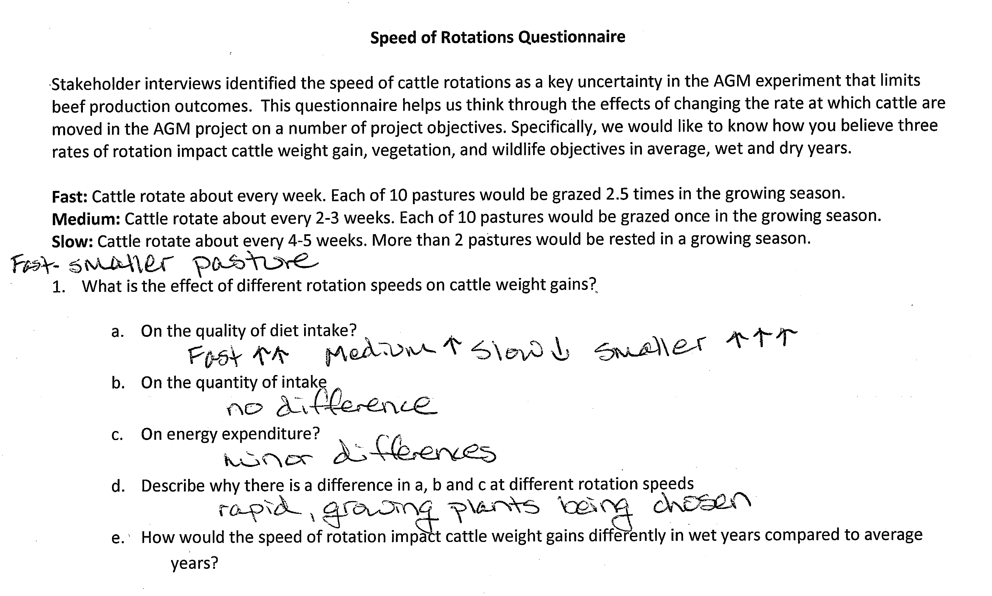
Key components of collaborative meetings:
Delving into mental models
Notes:
To think through results, we have to examine the mental model of how this system works, we have thought exercises and scenarios working in groups often to think more about outcomes of our decisions and what the results are telling us.

Slide 20
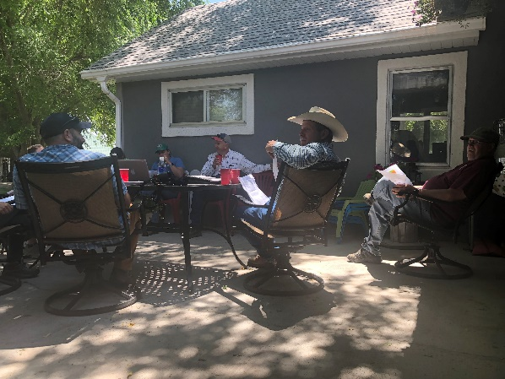
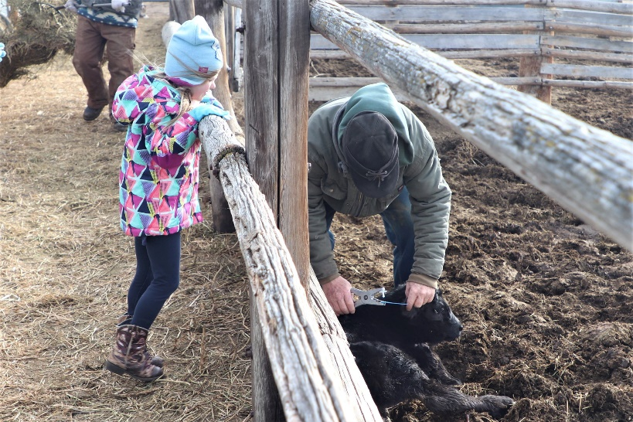
Key components of collaborative meetings:
Sharing food and building community
Notes:
It took about 3 years worth of meetings to go from a bunch of stakeholders to get to a collaborative community group, trust doesn’t happen fast. This slide represents an evolution from only the confines of the meeting space to Steve’s backyard, to Andy’s place during calving.

Slide 21
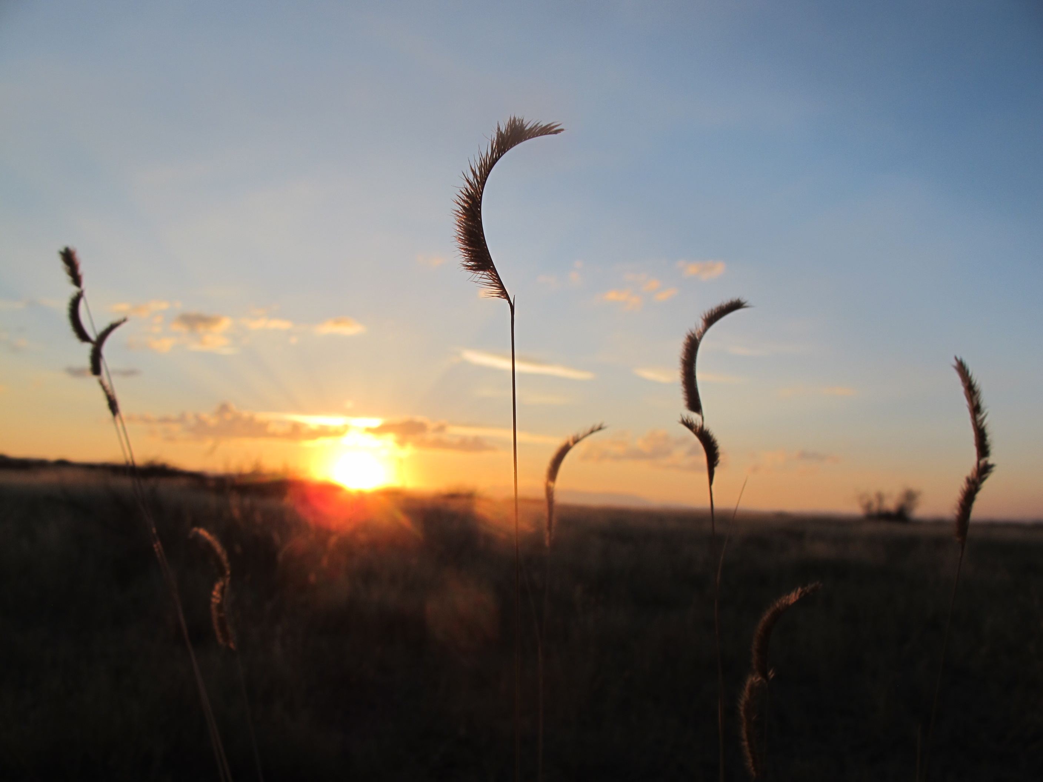
What have we learned?
“I think when we first started, everybody was kind of out for their own. All I really cared about was cattle gains, but after some heated conversations and getting to know all the objectives, now I look at it as I want to meet the cattle objective, but also the bird objective and the grass objective. I’ve learned a lot about inter-pasture heterogeneity … and then how cows gain better because of other reasons not just cow triggers. So we have to come together and work for all those objectives.”—Rancher Stakeholder
Notes:
This in a quote early on in the process, but originally the ranchers were only interested in cattle weight gains, NGOs about birds etc, all siloed, and the group actually voted to agree to try to achieve all objectives, now we do (and we know there may be trade-offs. Didn’t know how to handle trying to reach all objectives, so the vote seemed to really help with that.

Slide 22
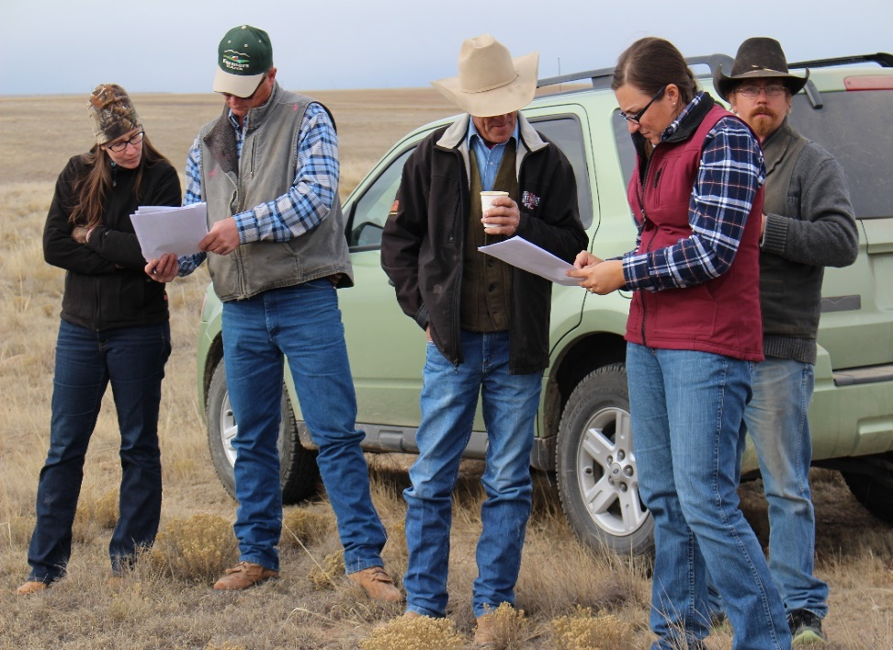
Key outcomes of collaborative process:
Increased trust and engagement among stakeholders and between stakeholders and researchers
Stakeholders appreciated working together to make decisions over a long (10-year) time frame.
The importance of participatory processes in facilitating trust is key to project success (Wilmer et al. 2018).
Conversations are evolving
  “How many lbs/acre of residual grass does a McCown’s Longspur need?”
Notes:
What we have seen is an increase in trust and that participatory processes must facilitate trust, which takes time. I’ve also noticed my conversions with ranchers evolving, they incorporate birds in their language and I incorporate rangeland components into bird conservation.

Slide 23
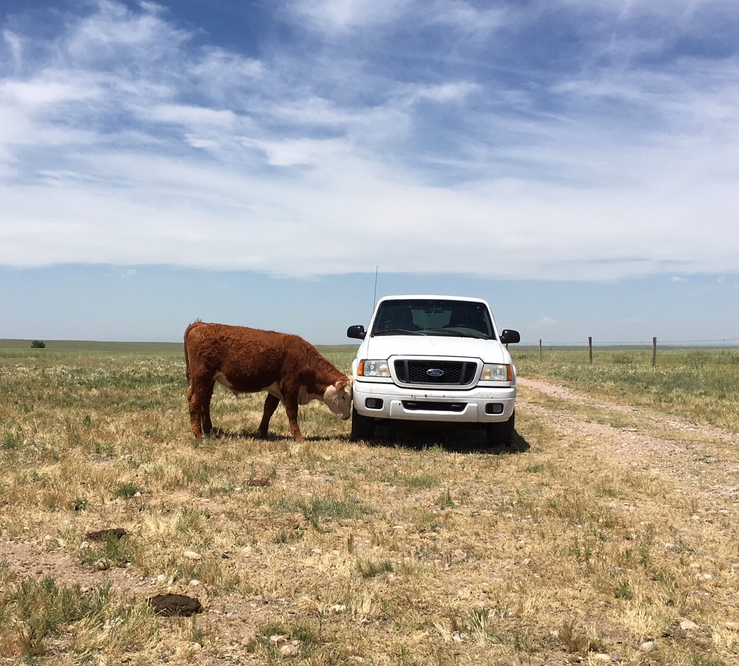
Key outcomes of collaborative process:
    Provided opportunity to develop understanding and respect for each other’s worlds, ways of learning, and knowledge.
    Conservation NGOs learned how to integrate understanding of rancher livelihoods into bird conservation and vise versa.
Notes:
This reiterates finds from the previous slide, learning to respect.

Slide 24
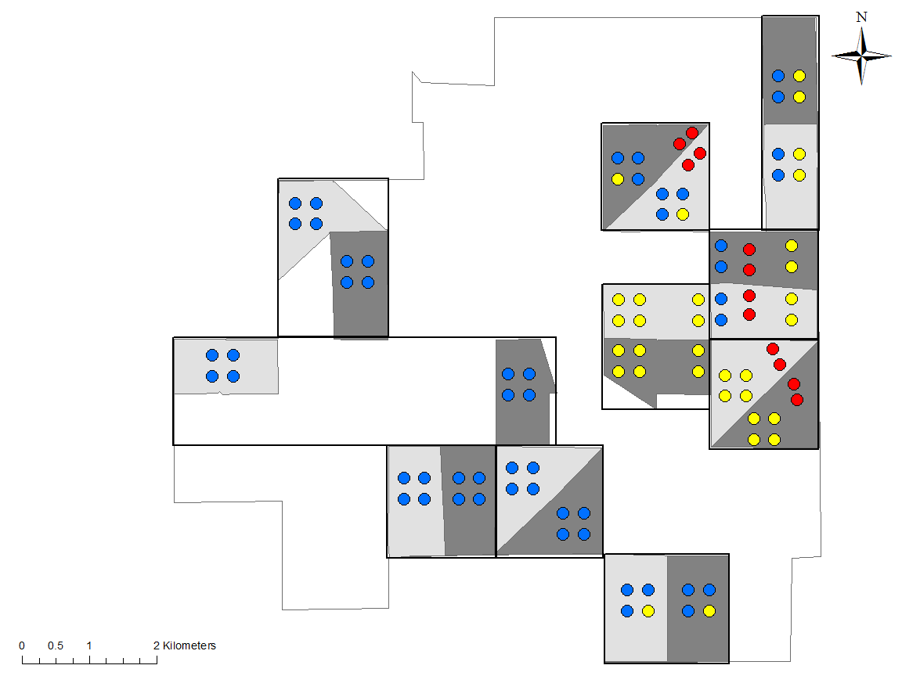
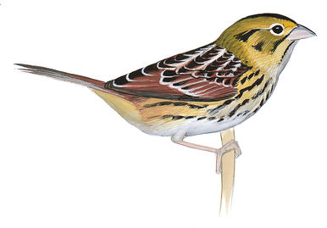
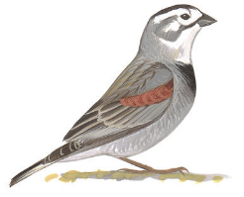
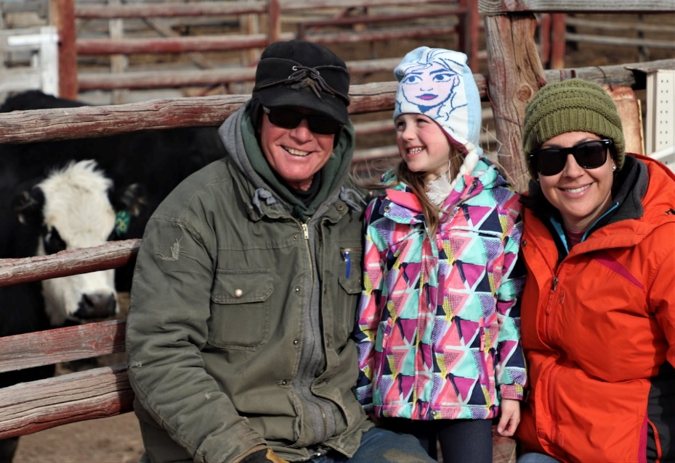
Thoughts on applying CARM more broadly:
    “Collaboration moves at the speed of trust”
    How do NGO’s adopt a process that does not often align with funding deliverables and deadlines.
      We have to be deliberate about building it into our funding models
      Partner with the “collaborative experts”
    Would we be more successful on the landscape with a more collaborative approach, taking aspects of CARM that can work?
Notes:
The first bullet here sums it all up. One huge challenge for NGOs and agencies is not being deliberate about funding models to support collaborative efforts. In the graphic above, we know different species occur in the same relative space as indicated here, two different grassland birds that need very different habitats, this is a map of the CARM station. We know need spatial prioritization in bird conservation and we know we may not be able to conserve all areas, adopting more collaborative approaches could help with this.
Trust is the absolute binding force in the work we do and in collaboration success, one big challenge at Bird Conservancy is aligning our goals with those of our primary partners (NRCS and State Wildlife agencies), when multiple spp occur on a ranch how do you manage for both or all? While it is complicated, we aren’t even doing it at all.

Slide 25
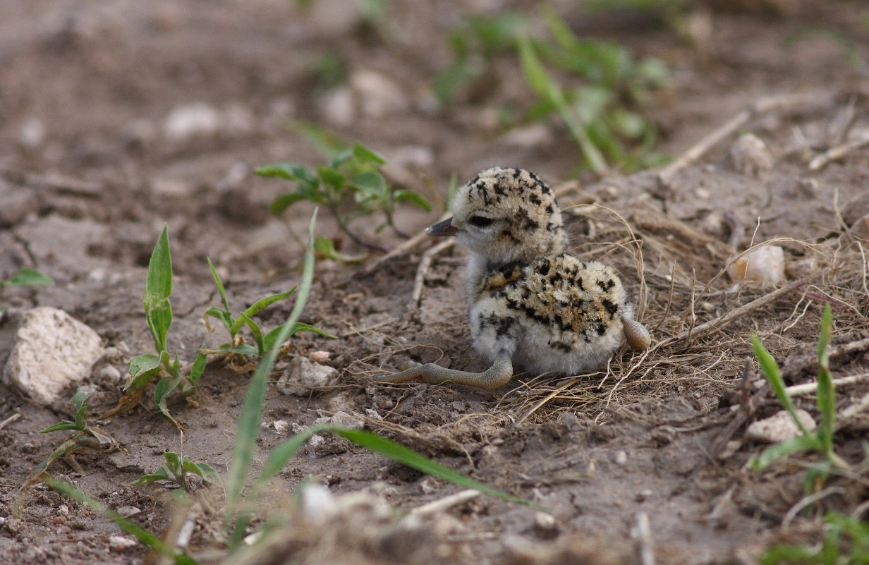
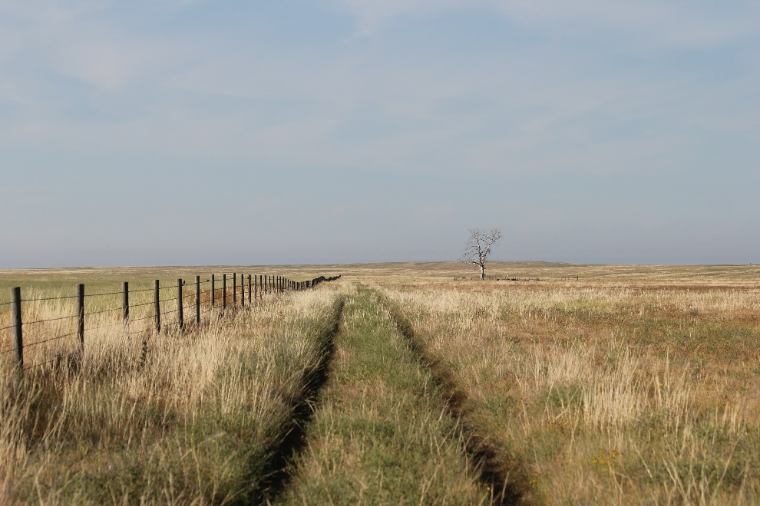
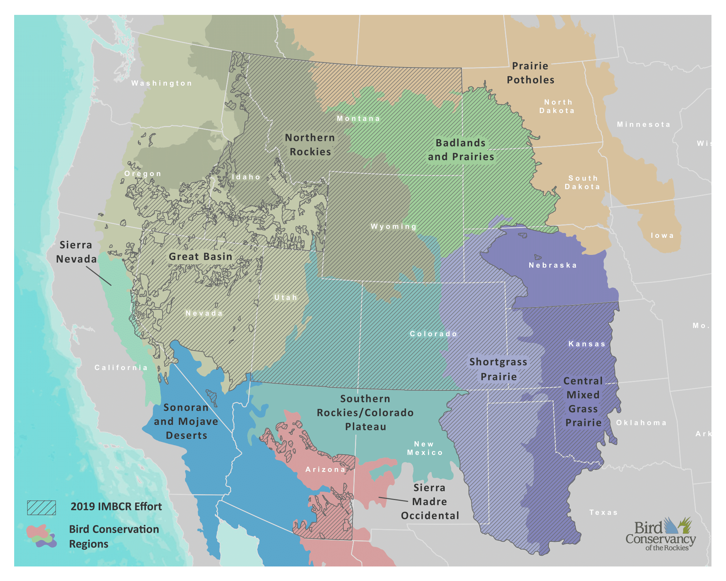
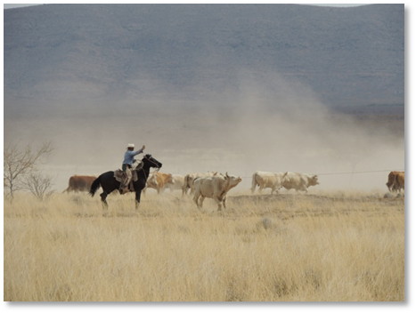
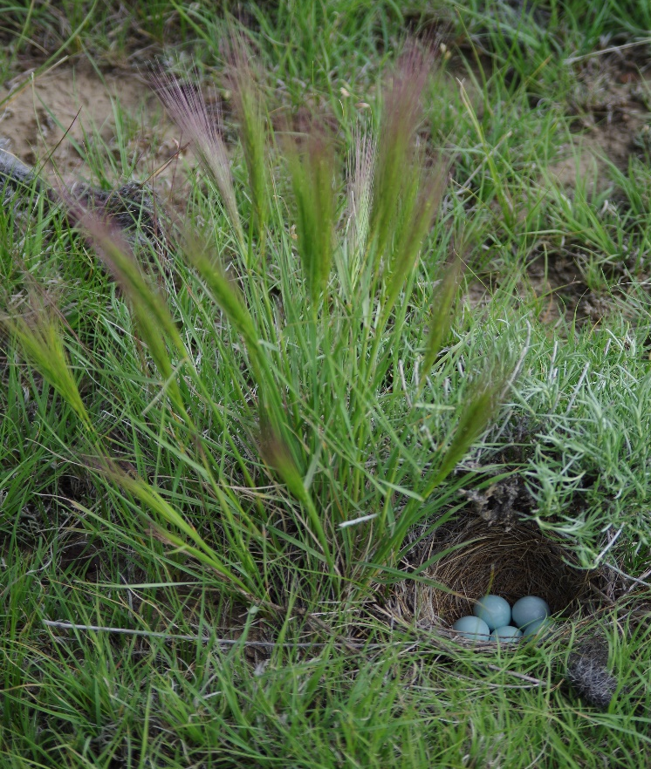
Private Lands Wildlife Biologist locations
Notes:
This map shows where our private lands biologists are based in the region, all out of NRCS offices working with private landowners, they have the opportunity to initiative collaboratives.
Internally we struggle with a collaborative process combining the strength of our science team who conduct large-scale bird monitoring in all these areas, and relationship building and connection with private landowners from our stew bio. We can do better there too.

Slide 26

Key Outcomes: CAM is not a circle, but rather a spiral. Path-dependency makes it impossible to repeatedly adjust a single system component in isolation.
Assess
Adjust
Design
Evaluate
Implement
Monitor

Slide 27
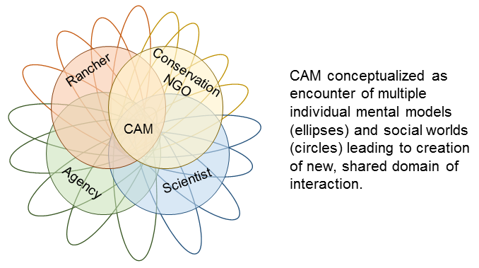
Key Outcomes: Public participation is not singular (i.e. there is no unitary “public”), but rather the intersection of many different mental models and social worlds.
CAM makes visible, but does not reconcile, differences among stakeholder knowledge sources.

Slide 28
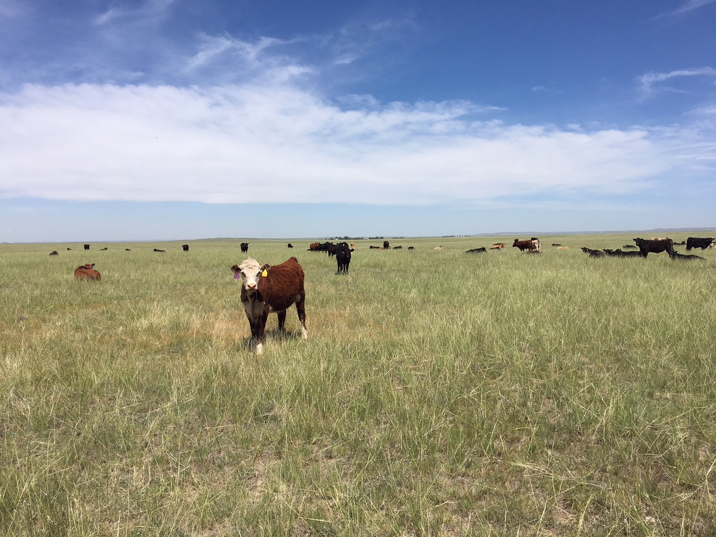
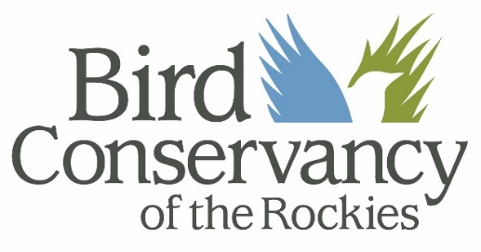

Email us: David.Augustine@usda.gov
Angela.Dwyer@birdconservancy.org
Digital Fact sheet: https://spark.adobe.com/page/cDD9u5v5ZeC88/

