Slide 1
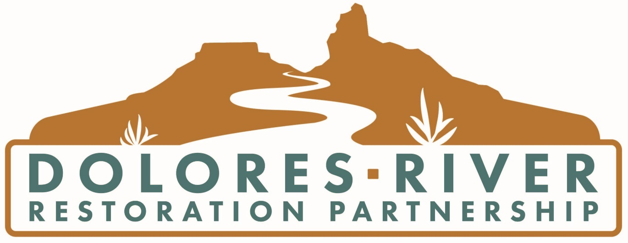
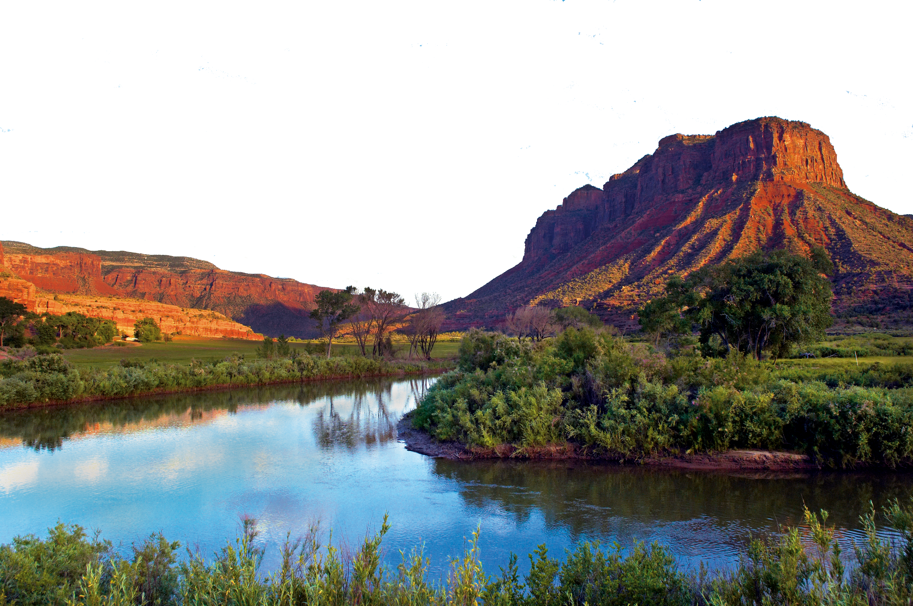

Slide 2
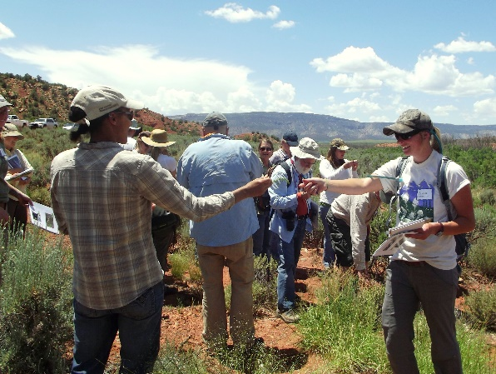
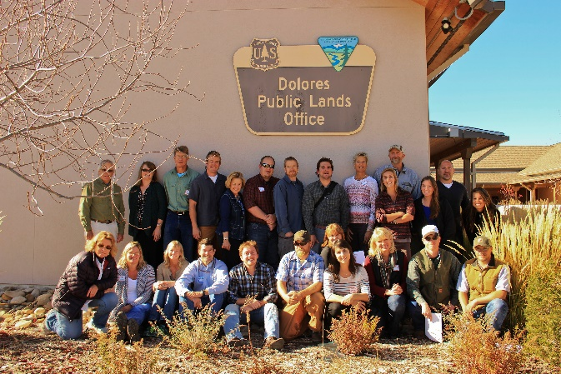
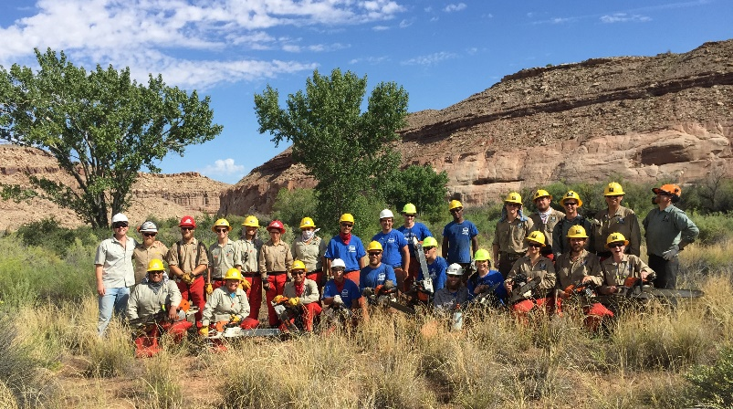
What is the
Dolores River Restoration Partnership (DRRP)?
The DRRP is a public-private collaboration of local, state and federal agencies, local schools, universities, nonprofit organizations, landowners, and citizen volunteers that share a common set of goals and principles for restoring the riparian habitat of the Dolores River.
Notes:
The Dolores River Restoration partnership is an umbrella partnership of many different public and private entities. Initially it was formed by TNC, Southwest Conservation Corps, and Tamarisk Coalition (now RiversEdge west). The partnership has gone through many different phases of governance and various subcommittees, but has maintained a core group. Currently, SCC and REW coordinate most frequently with the BLM to implement shared goals from the partnership. We have a pretty diverse set of funding sources including CWCB, state of Utah’s Watershed restoration Initiative, the BLM, some donation money and private foundations.

Slide 3
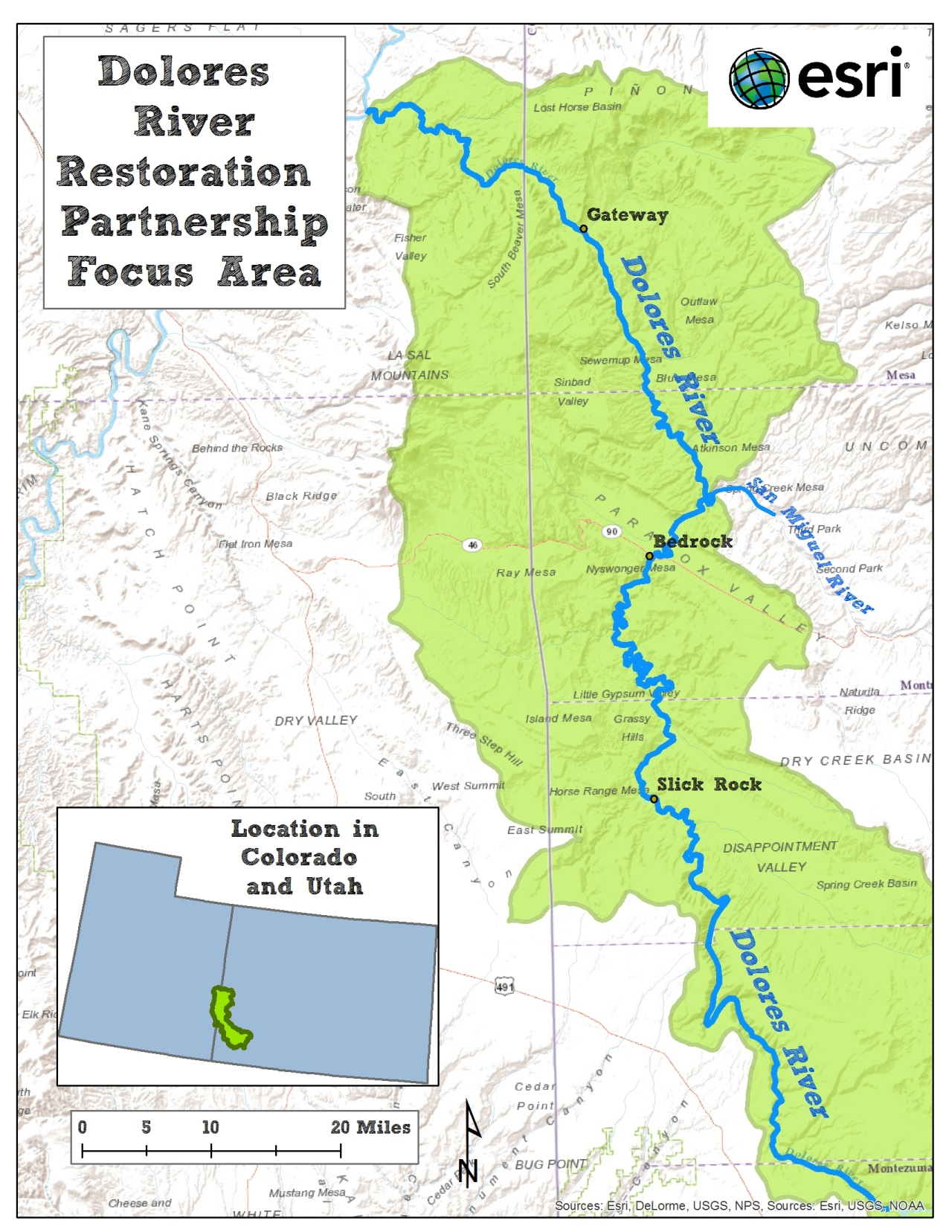
This Focus Area Includes:
Almost 200 miles of the Dolores River in Southwest CO & Southeast UT
Several tributaries to the Dolores, including the San Miguel River & Disappointment Creek
2 states, 4 BLM field offices, 6 counties

Slide 4
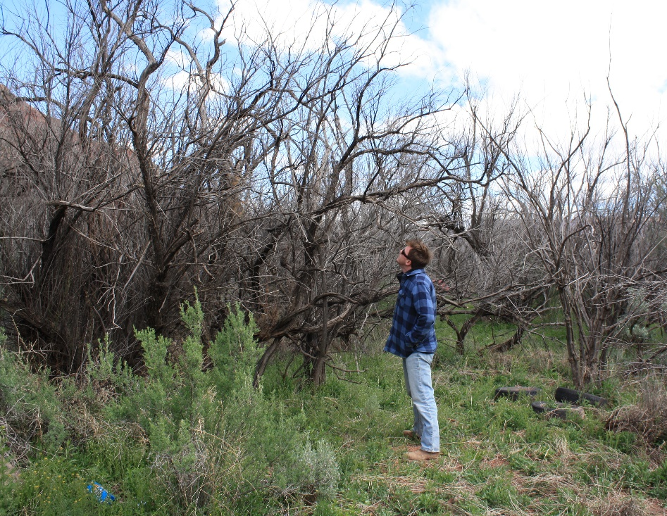
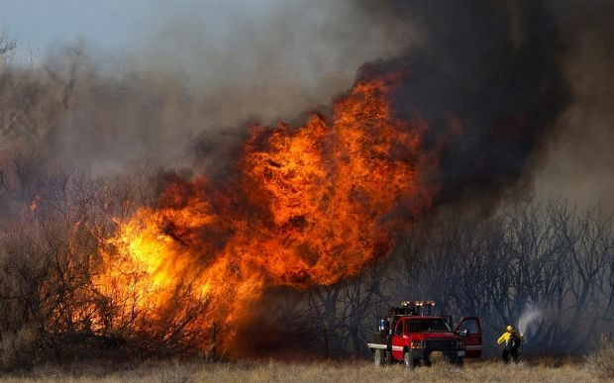
A Shared Problem Recognized in 2009
Along nearly 200 miles of the Dolores River, invasive plant species had:
Displaced native plant communities
Impaired wildlife habitat and forage
Hindered recreational opportunities
Increased risks associated with wildfire

Slide 5
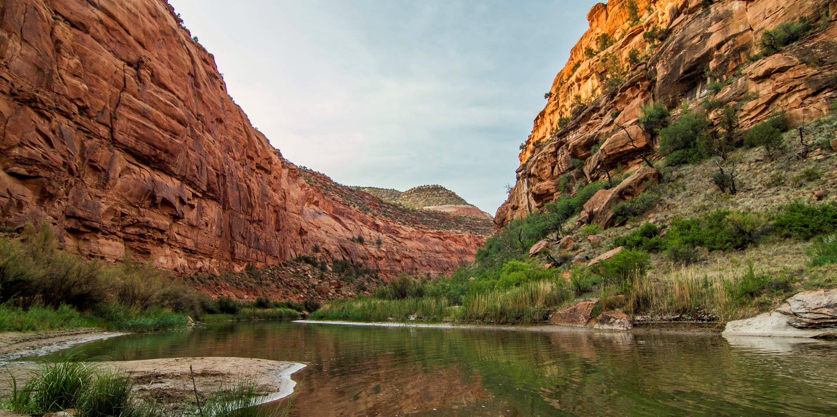
Vision: The Dolores River watershed is dominated by native vegetation, where the threats from tamarisk and other associated invasive species have been mitigated and the riparian areas of the watershed continue to become more naturally functioning, self-sustaining, diverse, and resilient over time.

Slide 6
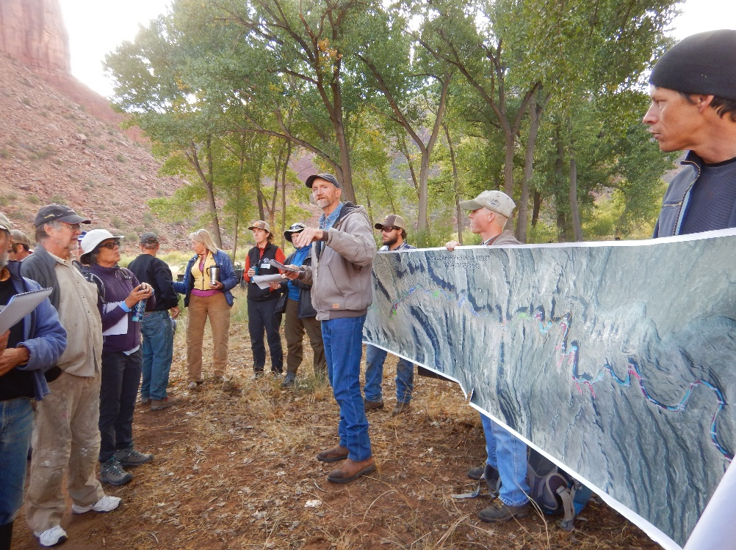
4 Shared Partnership Goals:
Ecological Goals: enhanced plant communities
Social Goals: youth, public safety, and aesthetics
Economic Goals: employment, local investments, efficiency, and recreation
Management Goals: learning, sharing, and improving

Slide 7
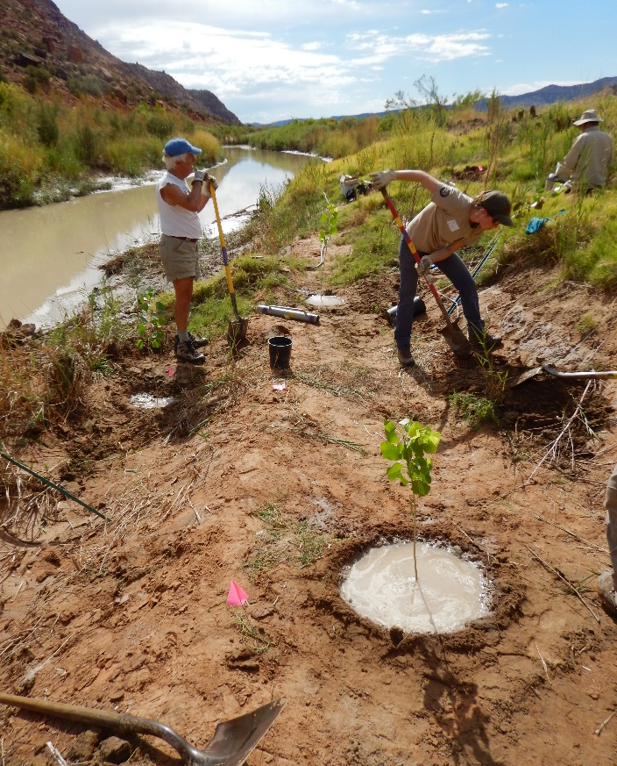
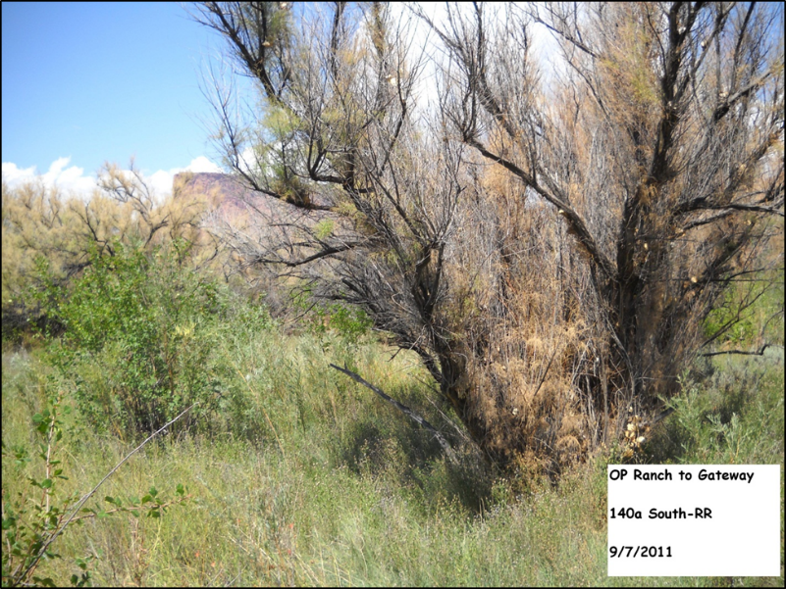
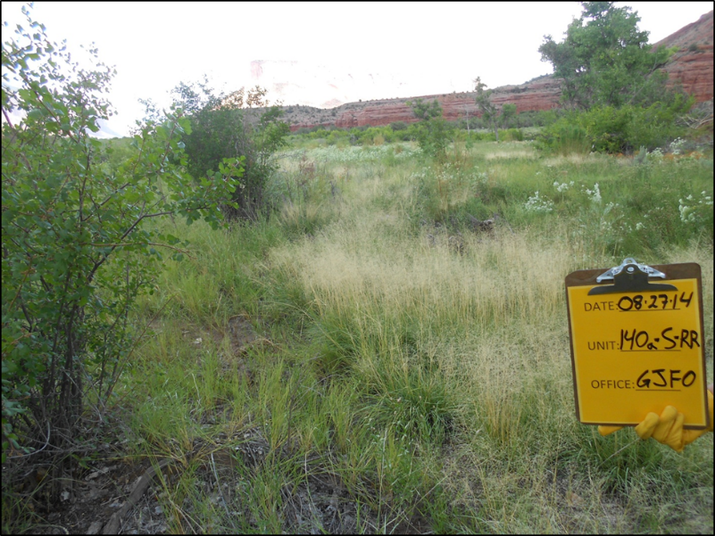
Since 2009, what has the DRRP done?
Removed over 2,200 acres of tamarisk (and treated many more secondary weeds)
Conducted over 500 acres of active revegetation
Hired and trained nearly 350 young adults through Conservation Corps programs
Raised over $9 million towards restoring the riparian corridor to a healthier state (invested in local economies).
Photos provided by GJ BLM
Notes:
The DRRP was first founded on a shared concern about the spread of tamarisk throughout the basin, and has made real tangible change. Since you folks live here, have likely noticed the difference made by the partnership since 2009.

Slide 8
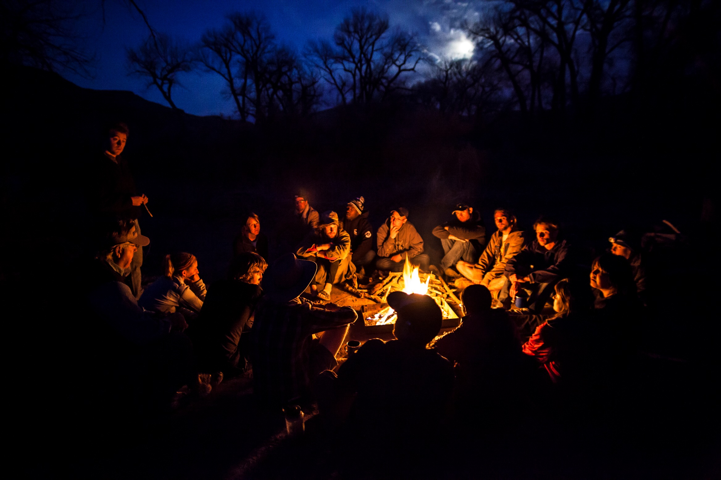
Key to Success?
TRUST
(Great working relationships)

Slide 9
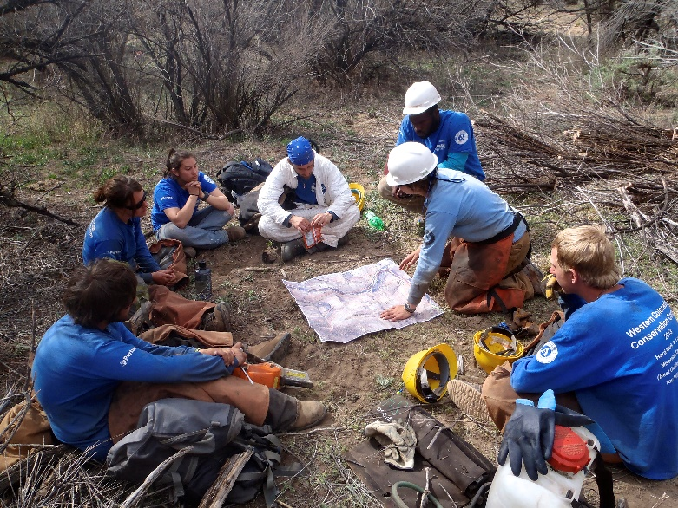
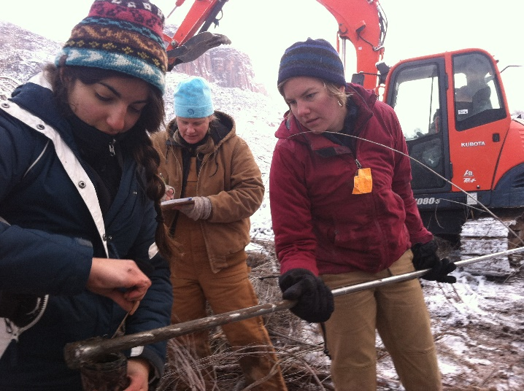
Collaboration and Shared Decision-Making
Realization that piecemeal approach toward large landscape restoration along the Dolores was insufficient.
Shared decision-making across public and private land parcels was necessary to achieve the partnership’s goals of restoring health to streamside habitat.

Slide 10
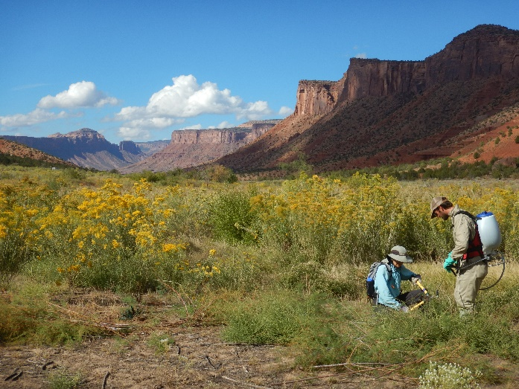
Key Partnership Resources
Dolores River Riparian Action Plan (2010):
A stakeholder-designed plan that guided the partnership through its formative years and is still relevant today.
Provides a framework that includes the partnership’s shared vision, goals, and criterion for prioritizing restoration work.
Initiated an increased level of collaboration and communication to enhance information transfer, adaptive management, and likelihood of large scale, meaningful success.
DRRP Monitoring and Maintenance Plan (2014):
Follow-up to the 2010 action plan, outlines long-term strategies to protect the partnership’s collective investments in the Dolores River riparian corridor.
Geodatabase:
One system for compiling monitoring data where all entries are consistent, quantifiable, and easily accessible.
Notes:
The partnership has developed a handful of guiding documents over the years in order to guide the work and goals. If anyone is interested in perusing these I can direct you to them online. We need to develop a new strategic and implementation plan as well for the next five years that prioritizes sites, and we will use input from partners and rely heavily on monitoring data.

Slide 11
Key Partnership Resources Continued…
Memorandum of Understanding (2015):
Affirmed roles and responsibilities, how partnership resources would be allocated & decisions made
30 signatories
DRRP Transition Plan (2015):
Guides the partnership in protecting investments made, transitioning into monitoring and maintenance, and in achieving long-term vision
5 year plan – will continue to update and transition as the partnership evolves
Annual Reports:
Summary of accomplishments
Provides a meaningful way to celebrate partnership success
Tangible resource for funders and stakeholders
Notes:
The partnership has developed a handful of guiding documents over the years in order to guide the work and goals. If anyone is interested in perusing these I can direct you to them online. We need to develop a new strategic and implementation plan as well for the next five years that prioritizes sites, and we will use input from partners and rely heavily on monitoring data.

Slide 12
MOU Signatories:
Bureau of Land Management: Tres Rios, Uncompahgre, Grand Junction, and Moab Field Offices
Bureau of Reclamation
Colorado Depart. of Transportation
Colorado Parks and Wildlife
Conservation Legacy’s Southwest Conservation Corps
Counties of Dolores, CO, San Miguel, CO, Montrose, CO, Mesa, CO, and Grand, UT
Department of Energy
Dolores River Boating Advocates
Four Corners School - Canyon Country Youth Corps
Gateway Canyons Resort
Natural Resources Conservation Service
Palisade Insectary
Paradox Valley Charter School
RiversEdge West
Rocky Mountain Bird Observatory
The Nature Conservancy
University of Utah – Rio Mesa Center
U.S. Fish and Wildlife Service, Partners for Fish and Wildlife
Utah Division of Wildlife Resources
Walton Family Foundation;
Western Colorado Conservation Corps

Slide 13
Resources to Withstand the Test of Time
All of the partnership resources provide:
Transparency
Clear direction
Unified voice
Solid systems (decision making structures, governance, fundraising)
Methods for transferring information and data during transition and succession
TRUST in the purpose and direction of the partnership

Slide 14
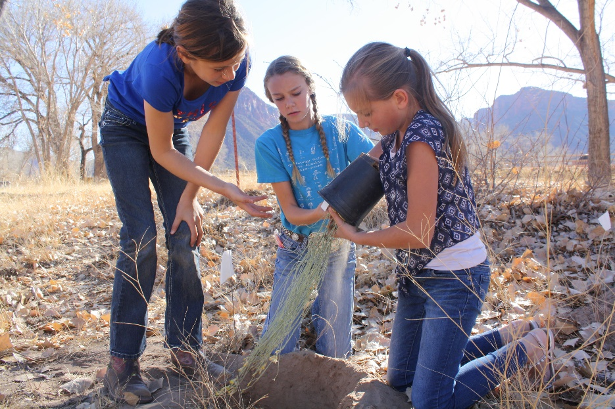
Dedication to Longevity
Maintaining trust requires:
Clear communication
Constant evaluation of what is working and what is not
Adapting to stakeholder needs
Staying nimble and responsive to funder requirements/ changes
Consistent messaging, education and outreach

Slide 15
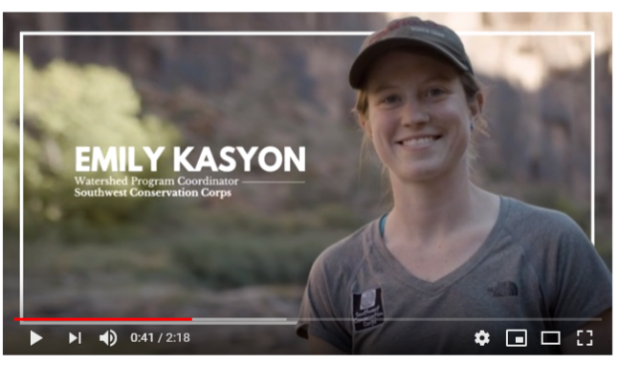
Telling the Story

Slide 16
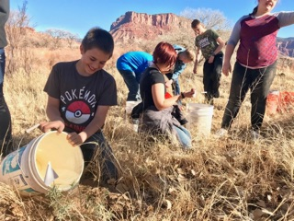
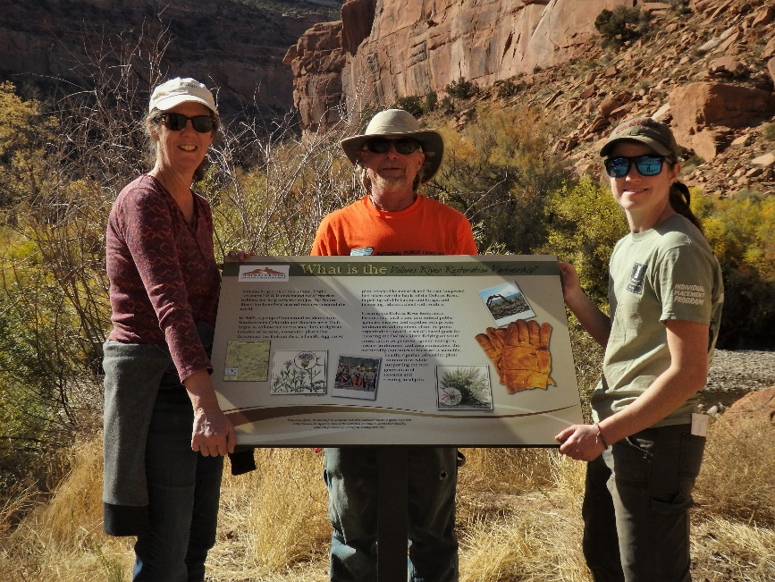
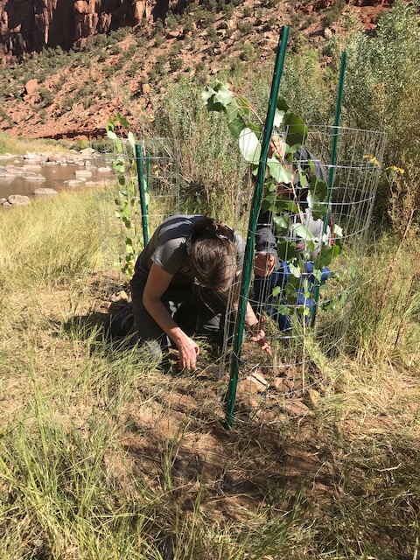
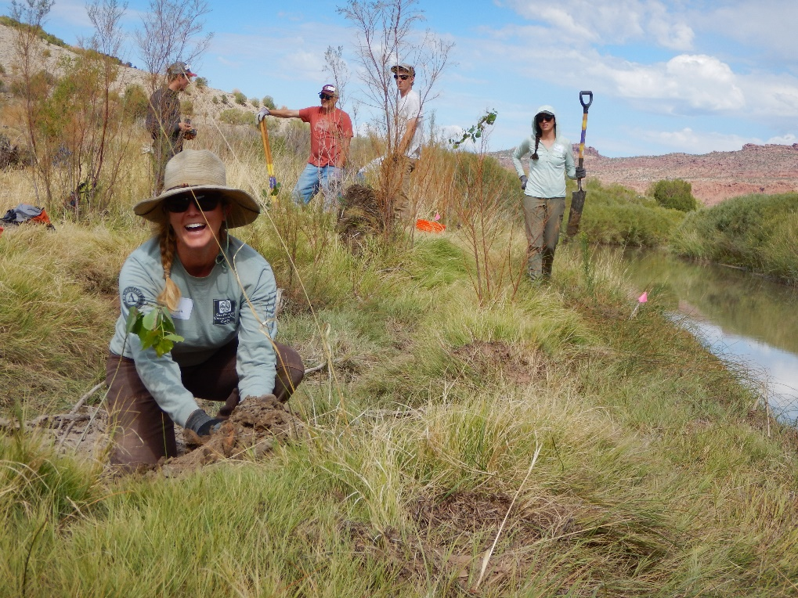
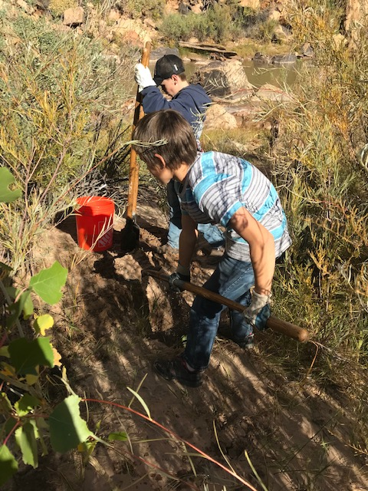
www.riversedgewest.org/events/dolores-river-restoration-partnership
Notes:
Describe pictures – other events

