Slide 1
WESTERN COLLABORATIVE CONSERVATION NETWORK
Grassland Carbon in
the Southern High Plains
March 11, 2020
Galen Guerrero-Murphy, Land Conservation Program Manager
The Nature Conservancy - Colorado

Slide 2
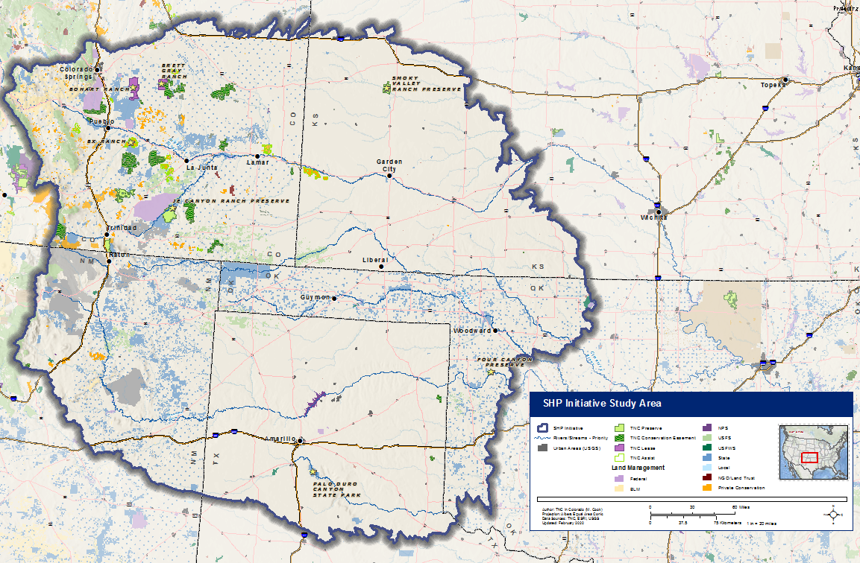
Southern High Plains Initiative
Notes:
68M acre planning area across parts of CO, KS, OK, TX and NM

Slide 3
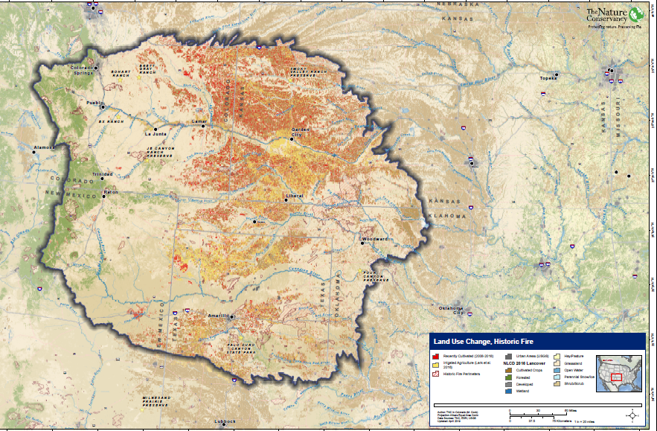
Land Use and Cultivation
Notes:
15.8M cultivated acres. ~4.7M of which occurred 2008-2018 (bigger than state of CT!). Tilling results in slow release of up to 30% of pre-existing grassland soil carbon.

Slide 4
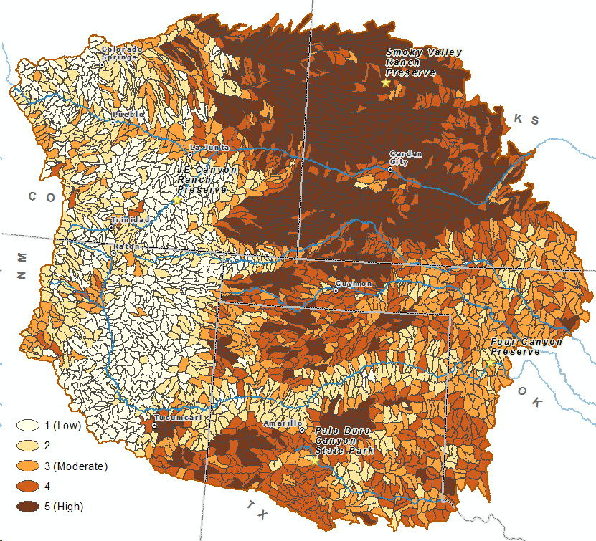
Agricultural Land Use Conversion (2008-2018)
Pixel to pixel change in cropland cover between 2008 Cropland Data Layer (CDL) and 2018 CDL
Dataset derived shows what landcover types were converted to agriculture within the timeframe
Overlay as the quantile distribution of area converted / HUC12
Notes:
-

Slide 5
Climate Mitigation Potential of 21 Natural Climate Solutions in the United States
Source: Fargione et al., Science Advances (2018)
Notes:
Op for 107M tons annually from avoided grassland conversion!

Slide 6
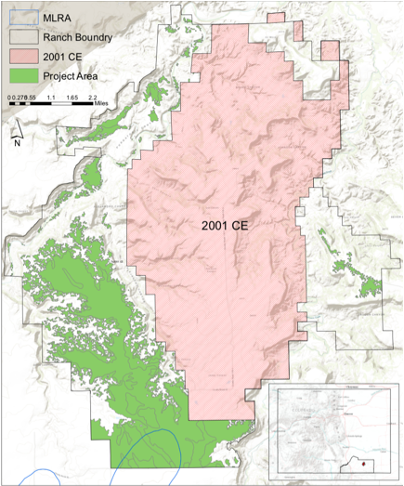
JE Canyon Ranch Scoping Project
Climate Action Reserve “Grassland Protocol”
Eligibility is based on 4 factors:
Additionality – would conversion have occurred without the project, and would project occur without the voluntary carbon market?
Past land use – native grassland for over 30 years
No trees – <10% tree cover
Soil quality – could soil sustain tilled agriculture
Productivity (stratification) based on:
Soil texture
Major land resource area (MLRA)
Past land use
Notes:
Thanks Brad Cory!
At our JE Canyon Ranch, we identified ~7,300 eligible acres for development under CAR’s Grassland Protocol, which would generate ~6800 CRTs annually for first 10 years. 50-year protocol, ~250,000 CRTs total.
Additionality – Performance (financial—e.g., county cropland premiums, and suitability—e.g., soils); Legal (protection not otherwise required nor is cultivation otherwise restricted); and Credit Stacking Conservation Easement is REQUIRED.

Slide 7
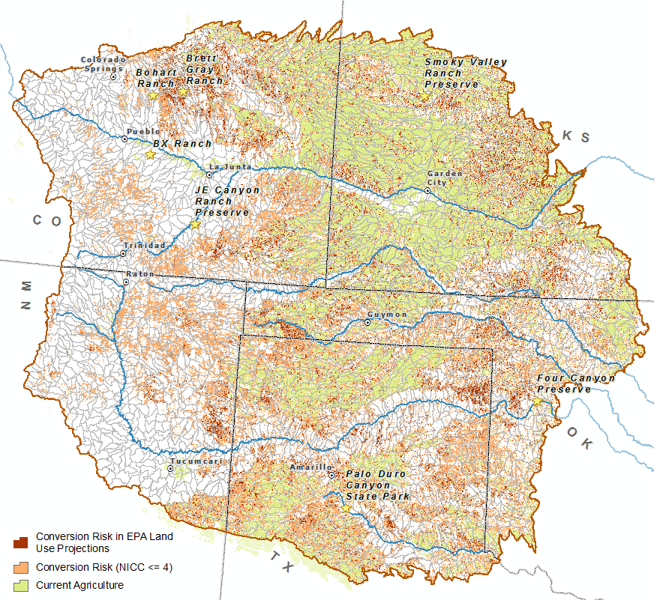
EXPLORING SHPI CONVERSION RISK AND GRASSLAND CARBON
18.3M unprotected, intact grassland/shrubland acres rated “Non-irrigated Capability Class” 1-4 (SSURGO)
3.9M of these acres are within EPA Integrated Climate and Land-Use Scenarios (ICLUS) Land Use/Landcover Change Projections
Notes:
NCS / Avoided Grassland Conversion carbon opportunity.
Can this become an important component of financing the conservation easement portion of the purchase-protect-resell model?
Note, still need to evaluate intersection of RCN, data for SRM was just recently released.

Slide 8
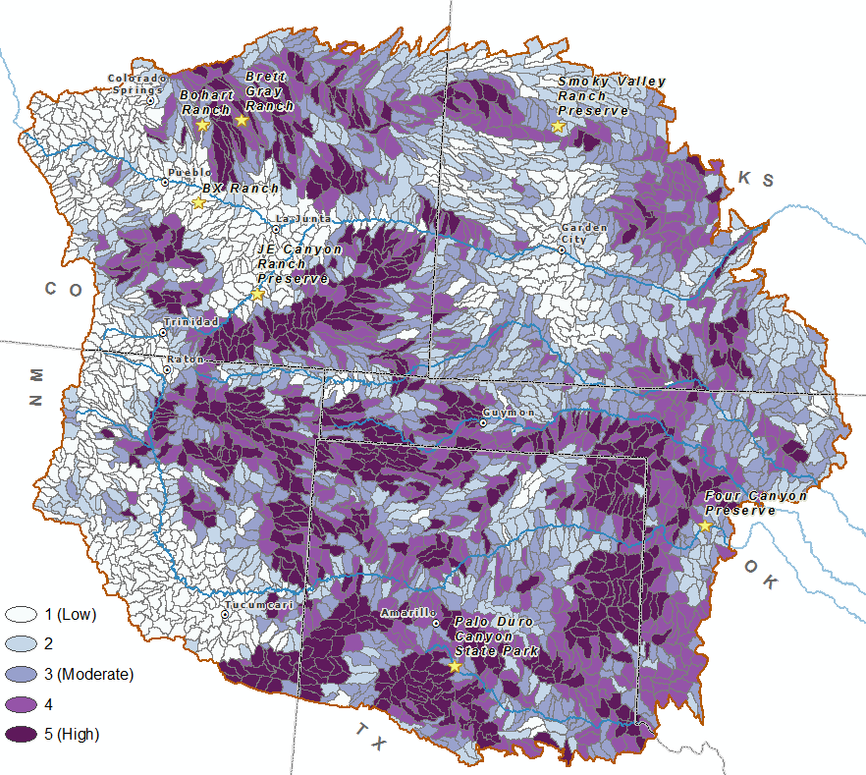
Cultivation Risk
NRCS SSURGO Non-Irrigated Capability Class (1-4) minus current agriculture, developed land, and public/private protected lands. Limited to only shrubland and grassland landcover types to show risk of conversion. Mapped as percent of HUC at risk.
This dataset is represented as “Cultivation Risk (NICC <= 4)” in the previous map.
Notes:
-

Slide 9
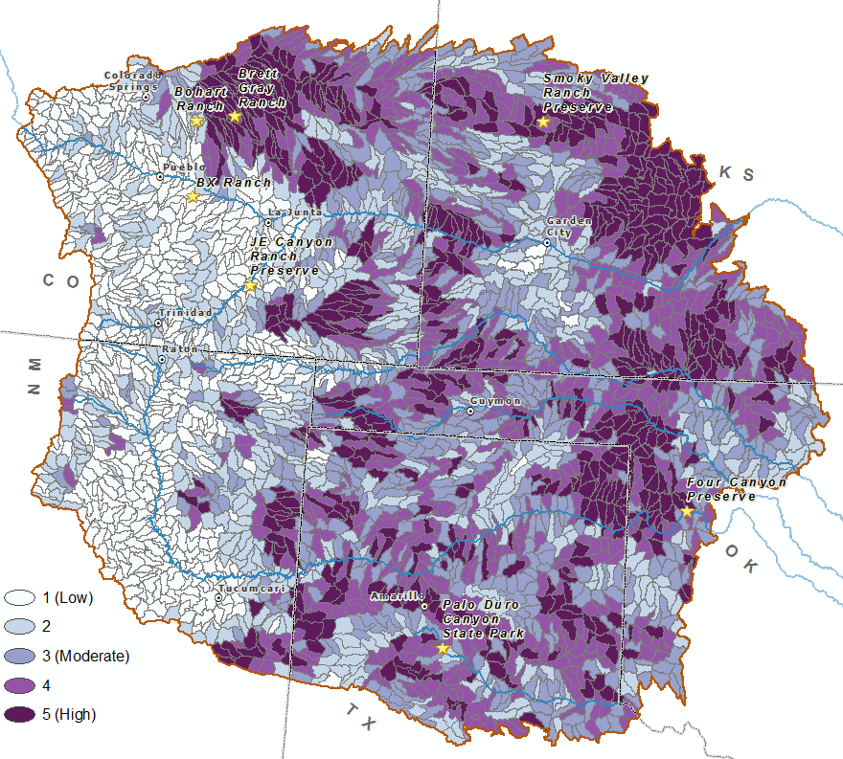
Cultivation Risk / LULC Projected Change
NRCS SSURGO Non-Irrigated Capability Class (1-4) minus current agriculture, developed land, and public/private protected lands. Limited to only shrubland and grassland landcover types to show risk of conversion.
This data is now constrained by the projected shift to Agriculture based on the EPA ICLUS.
This data is represented as “Cultivation Risk in EPA Land Use Projections” in the previous map.
Notes:
-

Slide 10
SUMMARY
In Southern High Plains, 4.7M acres were tilled and cultivated during the period 2008-2018 (releasing ~30% of soil carbon)
Potential expansion of non-irrigated cultivation on approximately 18.3M acres.
Opportunity to leverage Natural Climate Solutions and carbon offsets, particularly Avoided Grassland Conversion projects, for land protection financing
Biodiversity, community and climate co-benefits
Notes:
3.9M “preliminary priority” acres based on EPA data

Slide 11
DISCUSSION
How might we align and communicate “natural climate solutions,” such as grassland carbon storage, with more traditional conservation approaches?
What obstacles exist for the generation and sale of carbon offsets in rural communities and how might we overcome these obstacles?
How might grassland carbon markets synergize other conservation models, such as the WRCF buy-protect-sell model, or the WWF impact fund model?
How does the timing of payment for offsets effect conservation outcomes (e.g., lump sum payments now, versus smaller but steady long-term cash flows)?

Slide 12
WESTERN COLLABORATIVE CONSERVATION NETWORK
THANK YOU!
Galen Guerrero-Murphy, Land Conservation Program Manager
galen@tnc.org
(720) 504-5405

